Slide 1

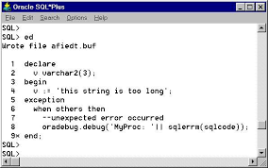
PL/SQL Cursors

Slide 2
What is Cursors ?
Oracle creates a memory area, known as context area, for processing an SQL statement, which contains all information needed for processing the statement, for example, number of rows processed, etc.
A cursor is a pointer to this context area. PL/SQL controls the context area through a cursor. A cursor holds the rows (one or more) returned by a SQL statement.
Notes:
It contains info about
SQL stmt.
Set of data returned or affected

Slide 3
Contd..
PL/SQL cursor is a mechanism by which
“ you can NAME that work area
and
manipulate the information within it”

Slide 4
Types of cursors
Two Types:
1) Implicit
2) Explicit

Slide 5
Cursor Attributes
Attribute | Description
%FOUND | Returns TRUE if an INSERT, UPDATE, or DELETE statement affected one or more rows or a SELECT INTO statement returned one or more rows. Otherwise, it returns FALSE.
%NOTFOUND | The logical opposite of %FOUND. It returns TRUE if an INSERT, UPDATE, or DELETE statement affected no rows, or a SELECT INTO statement returned no rows. Otherwise, it returns FALSE.
%ISOPEN | Always returns FALSE for implicit cursors, because Oracle closes the SQL cursor automatically after executing its associated SQL statement.
%ROWCOUNT | Returns the number of rows affected by an INSERT, UPDATE, or DELETE statement, or returned by a SELECT INTO statement.

Slide 6
Implicit Cursors
Implicit cursors are automatically created by Oracle whenever an SQL statement is executed, when there is no explicit cursor for the statement.
Programmers cannot control the implicit cursors and the information in it.
Whenever a DML statement (INSERT, UPDATE and DELETE) is issued, an implicit cursor is associated with this statement.
SELECT statement with INTO clause

Slide 7
Single Row Implicit Cursors
DECLARE
e_id employee.empid%TYPE;
e_name employee.empname%TYPE;
BEGIN
SELECT empid, empname INTO e_id, e_name
FROM employee where empid=23;
dbms_output.put_line( SQL%ROWCOUNT );
END;
/

Slide 8
Multiple Row Implicit Cursors(1)
BEGIN
UPDATE employee SET emp_sal= emp_sal + 5000
where emp_deptid=1;
IF SQL%FOUND THEN
dbms_output.put_line('Updated:'|| SQL%ROWCOUNT );
ELSE
dbms_output.put_line( 'Nothing Updated' );
END;
/

Slide 9
Multiple Row Implicit Cursors(2)
BEGIN
FOR e_cursor IN ( SELECT e_name FROM employee ) LOOP
dbms_output.put_line( e_cursor.e_name );
END LOOP;
END;
/

Slide 10
Cursor FOR Loop
Scope : Inside FOR Loop
Cursor Index :
- a pointer to Query work area.
- Query work area is a memory region ( context area )
Note:
SQL%ROWCOUNT attribute returns NULL.
Notes:
in the Oracle 11g Database Process Global Area(PGA)‏

Slide 11
Explicit Cursors
Explicit cursors are programmer defined cursors for gaining more control over the context area.
Define inside declaration block
It is created on a SELECT Statement which returns more than one row.
Static or dynamic SELECT stmt.
Open/Fetch/Close

Slide 12
Syntax
OPEN cursor_name [ (param1 , param2 ,....) ]
FETCH cursor_name INTO (variable1,variable2,....)‏
FETCH cursor_name INTO record_variable;
CLOSE cursor_name;

Slide 13
Cursors
Declaring an Explicit Cursor
CURSOR CursorName IS SelectStatement;
Opening an Explicit Cursor
OPEN CursorName;
Accessing Rows from an Explicit Cursor
FETCH CursorName INTO RowVariables;

Slide 14
Cursors
Declaring Variables of the Proper Type with %TYPE
VarName TableName.FieldName%TYPE;
Declaring Variables to Hold An Entire Row
VarName CursorName%ROWTYPE;
Releasing the Storage Area Used by an Explicit Cursor
CLOSE CursorName;

Slide 15
Explicit Cursors - Example
DECLARE
c_id customers.id%type;
c_name customers.name%type;
c_addr customers.address%type;
CURSOR c_customers is SELECT id, name, address FROM customers;
BEGIN
OPEN c_customers;
LOOP
FETCH c_customers into c_id, c_name, c_addr;
dbms_output.put_line(c_id || ' ' || c_name || ' ' || c_addr);
EXIT WHEN c_customers%notfound;
END LOOP;
CLOSE c_customers;
END;

Slide 16
Static Cursor
DECLARE
eid employee.empid%TYPE;
ename employee.empname%TYPE;
CURSOR cur IS
SELECT empid, empname FROM employee ;
BEGIN
OPEN cur ;
LOOP
FETCH cur INTO eid , ename;
EXIT WHEN cur%NOTFOUND;
dbms_output.put_line( 'NAME' || cur.ename );
END LOOP;
CLOSE cur ;
END;

Slide 17
Cursor For Loop
Processing an Entire Result Set Common
Special Form of FOR … IN to Manage Cursors
No Need for Separate OPEN, FETCH and CLOSE statements
Requires %ROWTYPE Variable

Slide 18
Eg- Cursor For Loop
DECLARE
CURSOR C IS
SELECT empid AS eid , empname AS ename FROM employee ;
BEGIN
FOR i IN C LOOP
dbms_output.put_line( 'NAME' || i.ename );
END LOOP;
END;
/

Slide 19
Static Cursor( Record)‏
DECLARE
TYPE emp_record IS RECORD ( eid NUMBER, ename VARCHAR2(30) );
employee EMP_RECORD;
CURSOR cur IS SELECT empid, empname FROM employee ;
BEGIN
OPEN cur ;
LOOP
FETCH cur INTO employee;
EXIT WHEN cur%NOTFOUND;
dbms_output.put_line( 'NAME' || employee.ename );
END LOOP;
CLOSE cur ;
END;

Slide 20
Static Cursor( Record+FOR Loop)‏
DECLARE
TYPE emp_record IS RECORD ( eid NUMBER, ename VARCHAR2(30) );
explicit_employee EMP_RECORD;
CURSOR cur IS SELECT empid, empname FROM employee ;
BEGIN
FOR i IN cur LOOP
explicit_employee := i;
dbms_output.put_line( 'NAME' || explicit_employee.ename );
END LOOP;
END;
/
Note: No Data Found , No error is raised

Slide 21
Static Cursor( No rows)‏
DECLARE
TYPE emp_record IS RECORD ( eid NUMBER, ename VARCHAR2(30) );
employee EMP_RECORD;
CURSOR cur IS SELECT empid, empname FROM employee where empid = -1 ;
BEGIN
OPEN cur ;
LOOP
FETCH cur INTO employee;
IF cur%NOTFOUND THEN
IF cur%ROWCOUNT = 0 THEN
dbms_output.put_line( 'No Data Found' );
END IF;
EXIT;
ELSE
dbms_output.put_line( 'NAME' || employee.ename );
END IF;
END LOOP;
CLOSE cur ;
END;

Slide 22
Parameterized Cursor
Parameterized Cursor pass the parameters into a Cursor and use them in to the query.
Parameterized Cursor defines only the datatype of Parameter and not need to define it's length.
Default values is assigned to the Cursor Parameters and Scope of the Parameters is local.
Parameterized Cursors are also Static Cursors that can be passed with Parameter Value when Cursor is open.

Slide 23
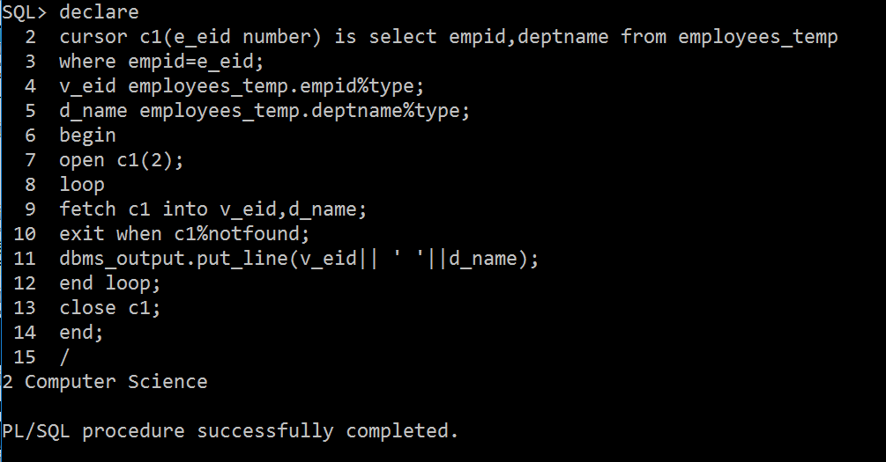
Example

Slide 24
Guided Activity-1
1) Create table rad_vals using SQL Command Line
a) Add Following Attribute
Radius of type number
b) Insert some records in the above table
2) Create table Area using SQL Command Line
a) Add following Attributes
Radius of type number with precision
Area of type number with scale and precision
Perimeter of type number with scale and precision
Using Cursors Find the area and perimeter of Circle and insert the value of radius and calculated area and perimeter in the area table
Estimated Time: 30 Minutes.

Slide 25
Guided Activity-2
Create table Employee using SQL Command Line
a) Add Following Attributes:-
Empno of type number
Deptno of type number
Ename of type varchar2
Edesignation of type varchar2
Salary of type number
b) Insert 06 records in the above table as per your choice.
Using Cursor find four highest salary of employee
Using Cursor update the salary of all employees with 5000
Using Cursor find the sum of salaries of all employees.
Estimated Time: 40 Minutes.

